Slide 1


Recruit-AI
An Agentic AI Hiring System That Screens, Interviews and Shortlists Candidates — Fully Automated
BUILT WITH LOVABLE
N8N
OPENAI
GEMINI
WHATSAPP

Slide 2

Hiring is Broken
Recruiters are losing great candidates to slow, inconsistent, and exhausting manual processes. The result? Decision fatigue, bad hires, and a poor candidate experience.
📄 Resume Overload
⏳ Slow Screening
Recruiters drown in PDFs and miss great talent buried in the pile.
Manual review takes days — top candidates drop off before you even respond.
⚖️ No Consistency
Different recruiters score differently every time. Bias creeps in, quality suffers.

Slide 3



The Solution
Meet Recruit-AI
A 3-stage agentic hiring funnel that runs on autopilot — from application to shortlist, without a single manual touchpoint.
Stage 1 — Screen
Stage 2 — Assess
Stage 3 — Decide
AI validates the resume and scores the lead out of 10 instantly.
WhatsApp chatbot conducts an async interview — no scheduling needed.
Recruiter reviews the full AI report and triggers next steps with one click.

Slide 4
The Candidate Experience
The Candidate Journey
From application to decision — every step is seamless, mobile-first, and fully automated.
01
02
03
Apply Online
Upload Resume
Meet Kie on WhatsApp
Candidate fills out the application form on the Recruit-AI portal.
Uploads their resume and submits all role-specific details.
Receives a WhatsApp message from Kie, the AI recruiting assistant, within minutes.
04
05
Async Interview
Outcome Delivered
Completes a 10-question interview on WhatsApp — on their own time, on their phone.
Gets a booking link if shortlisted — or a polite, professional rejection message.

Slide 5
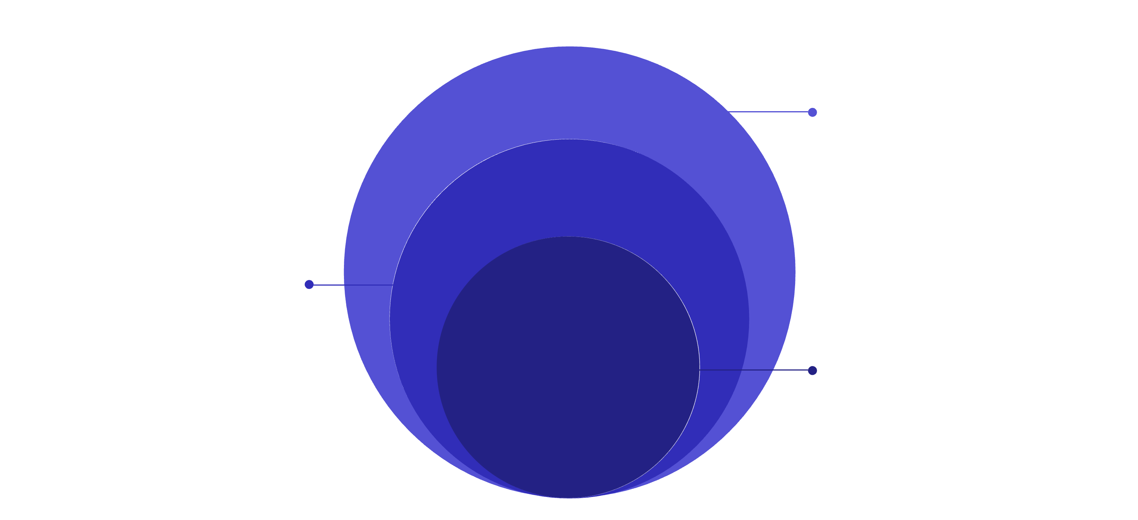
Technical Architecture
Under The Hood
Every layer of Recruit-AI is purpose-built for reliability, speed, and intelligent decision-making at scale.
Integration & Comms
Data storage and WhatsApp/Cal.com booking
Automation Engine
n8n workflows: webhooks, validation, agents
Core AI Layer
Resume rating and lead scoring
The automation engine orchestrates every handoff — from intake webhook to calendar invite — with zero manual intervention required.

Slide 6

Full Visibility for the Recruiter
What the Recruiter Sees
What the Recruiter Can Do
Candidate name, company, and role applied
Resume validity check + rating out of 10
Lead score out of 10 with full breakdown
AI-flagged green flags and red flags
AI recommendation badge: High Priority / Follow Up / Pass
Approve candidate → triggers WhatsApp interview instantly
Reject candidate → sends polite automated message
View the full WhatsApp transcript
Confirm whether the calendar invite was sent

Slide 7
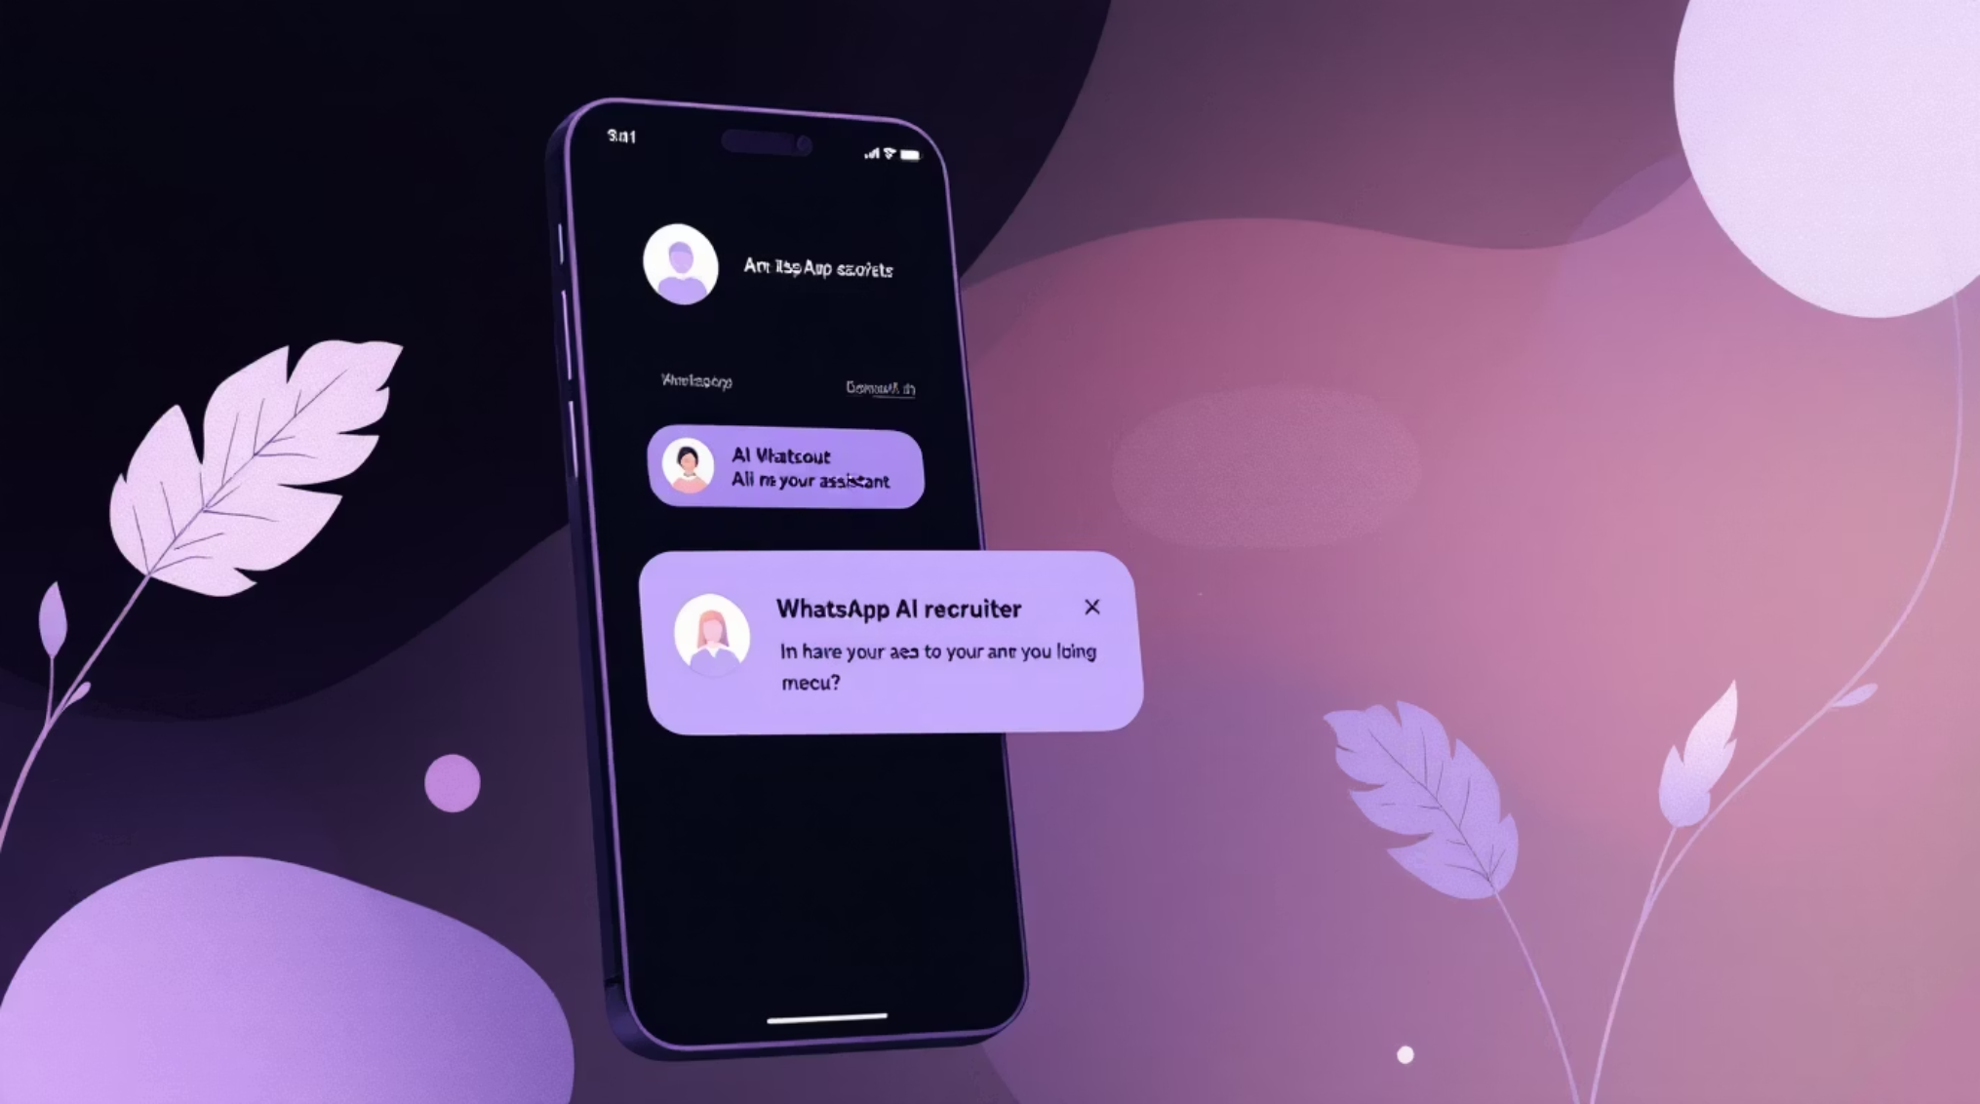
AI Interview
Meet Kie — Your AI Recruiter on WhatsApp
"I'm Kie, the recruiting assistant for this role 👋 Let's get started — I'll ask you 10 quick questions."
Asks 10 role-specific questions generated directly from the job description
Probes red flags and validates green flags surfaced from the resume
Sends a calendar booking link automatically when the candidate qualifies
Never reveals internal scores or assessments to the candidate

Slide 8
Validation Layer
Nothing Gets Through Unchecked
Three intelligent checkpoints ensure every candidate is evaluated fairly, thoroughly, and without human bias.
📄 Resume Check — Gemini Vision
🧠 Lead Scoring — OpenAI
✅ Interview Verification
After every WhatsApp reply, the AI verifies whether the calendar link was sent and auto-updates the candidate's status in the recruiter dashboard in real time.
Validates that the uploaded file is actually a resume. Rates it 0–10 across formatting, completeness, language quality, and role relevance.
Scores the applicant 0–10 across 7 dimensions: work experience, skills match, motivation, availability, salary expectation, location fit, and portfolio quality.

Slide 9
Candidate Transparency
Candidates Always Know Where They Stand
No logins. No app downloads. Candidates simply enter their email to check live status — works on any device, anywhere.
1
2
Applied
Under Review
"We've received your application. Hang tight!"
"Your resume is being reviewed by our AI system."
3
4
Interview In Progress
Decision Made
"Kie has reached out on WhatsApp — check your messages."
"A decision has been made. Check your WhatsApp for next steps."

Slide 10






Built Lean. Scales Fast.
Lovable
n8n
Frontend & dashboards
Automation engine
OpenAI GPT-4o
Gemini Vision
Scoring & interviews
Resume validation
WhatsApp API
Cal.com
Interview channel
Meeting scheduling
Recruit-AI removes the manual bottleneck from hiring. Recruiters focus on people — the AI handles everything else.
Screen Smarter. Interview Faster. Hire Better.

